Slide 1

Green University of Bangladesh Department of Computer Science and Engineering(CSE)
Faculty of Sciences and Engineering Semester: (Fall , Year:2022), B.Sc. in CSE (Day)
LAB REPORT NO : 4
Course Title : Structured Programming Lab
Section : DC
Course Code : CSE 104
Student Details
Name | ID
Md. Sohan Millat Sakib | 222902036
: 08-11-2022
Lab Date Submission Date : 13-11-22 Course Teacher’s Name
: JARIN TASNIM TONVI
[For Teachers use only: Don’t Write Anything inside this box]
Marks:.....
Comments:
Lab Report Status
Signature: Date:.........

Slide 2
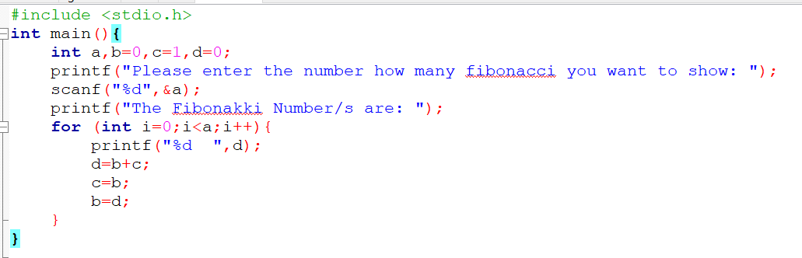
Problem 1:
Title: Write a C program of the Fibonacci series.
Objectives:
To be familiar with scanf and printf functions.
To be familiar with the logical expression.
To be familiar with for loop.
Input & Output:
At first, we have to read a value which is the number of Fibonacci. A Fibonacci number is a number that is the resultant of the earlier two numbers.
Implementation:

Slide 3
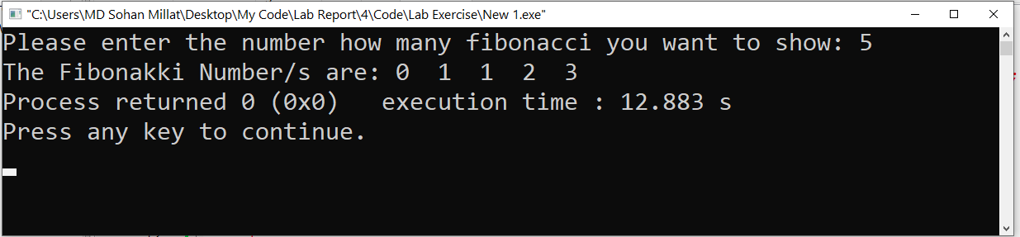
Test Result:
Discussion: For solving this problem I have to know about the Fibonacci number series and how it works.
Problem 2:
Title: Write a C program to swap the first and last digits of any number.
Objectives:
To be familiar with scanf and printf functions.
To be familiar with if else conditions.
To be familiar with the logical expression.
To be familiar with loop and swap.
To be familiar with power function.
Input & Output:
At first, the program read a value from the user. Then it swaps the first digit into the last digit and the last digit into the first digit. And then print the number.

Slide 4
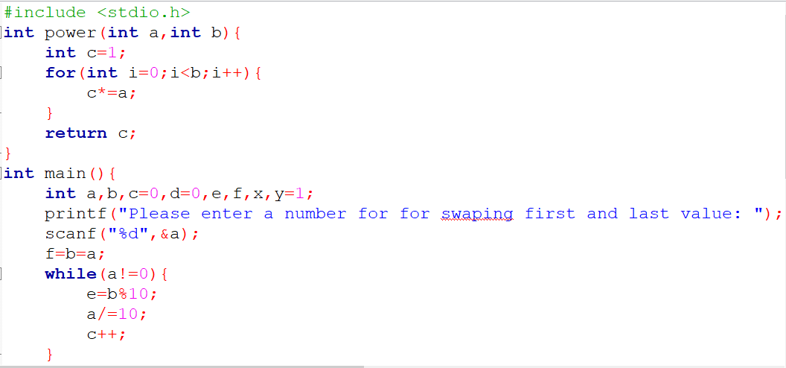
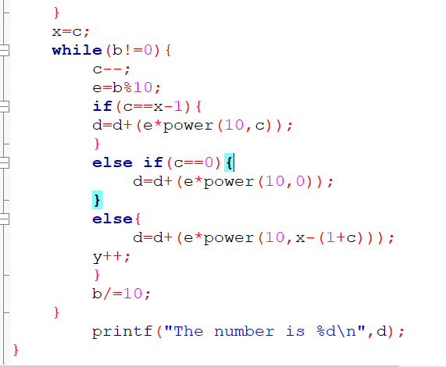
Implementation:

Slide 5
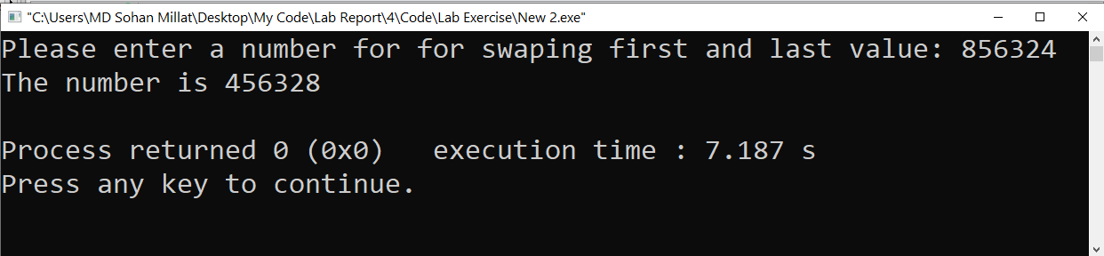
Test Result:
Discussion: When I solve this question I face some problems. Actually this problem is quite complex. Then I think about it mathematically and solve it.
Problem 3:
Title: Write a C program to calculate the product of digits of any number.
Objectives:
To be familiar with scanf and printf function.
To be familiar with switch case condition.
Input & Output:
This program are input a number from the user. Then seperate all digit from the number and product them.

Slide 6
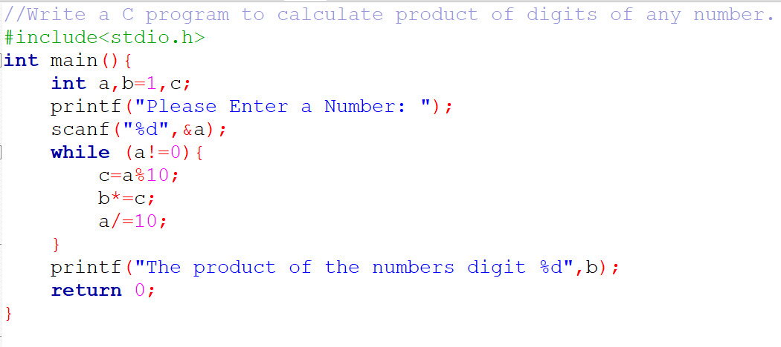
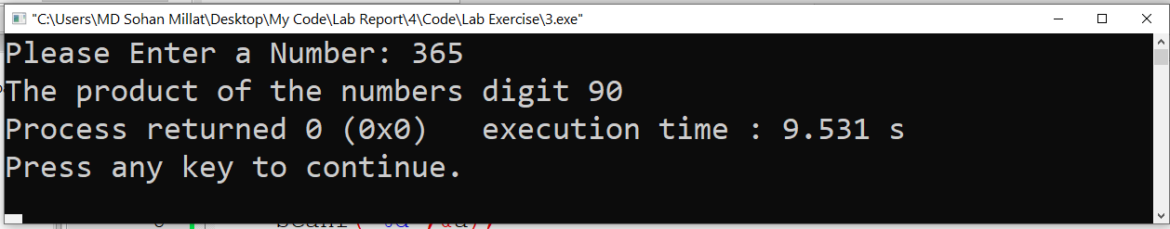
Implementation:
Test result:
Discussion: When I solve this programme I don’t face any problem.

Slide 7
Problem 4:
Title: Write a program in C to find the sum of the series 1 +11 + 111 + 1111 + .. n terms.
Objectives:
To be familiar with scanf and printf function.
To be familiar with if else condition.
To be familiar with logical expression.
Input & Output:
AT first the programme input a number from user. Then the programme sum all the value flowing the sequence of question and print the summission…

Slide 8
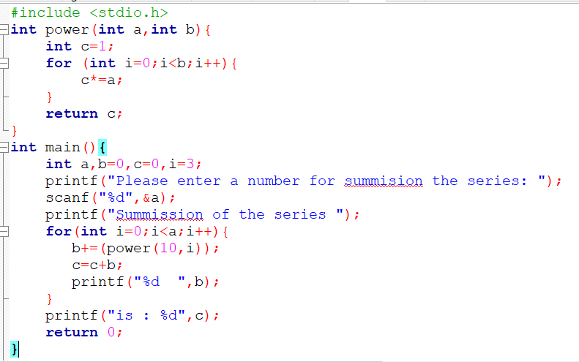
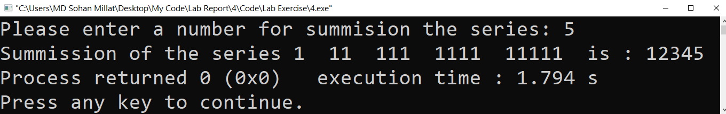
Implementation:
Test result:
Discussion: To solve this problem I don’t face any problem…

Slide 9
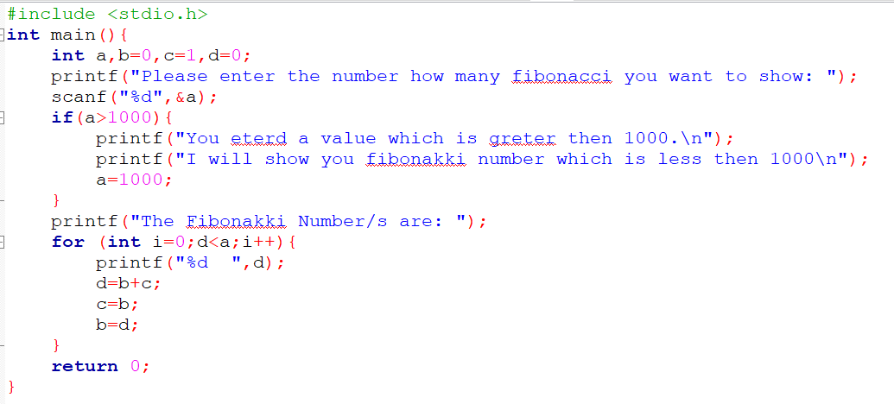
Problem 5:
Title: Print Fibonacci series until a given number. For instance, if a user wants to print Fibonacci series until1000, print all the Fibonacci number below 1000.
Objectives:
To be familiar with scanf and printf functions.
To be familiar with the logical expression.
To be familiar with for loop.
Input & Output:
At first, we have to read a value which is the number of Fibonacci. A Fibonacci number is a number that is the resultant of the earlier two numbers. If use enter a value which is greater than 1000 it also print Fibonacci which is less then 1000.
Implementation:

Slide 10
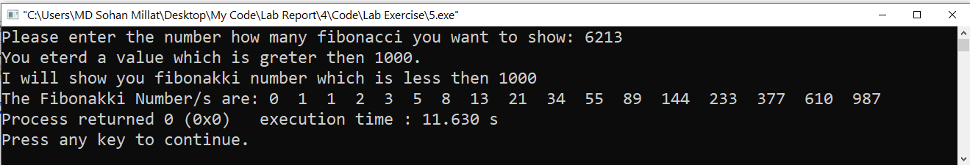
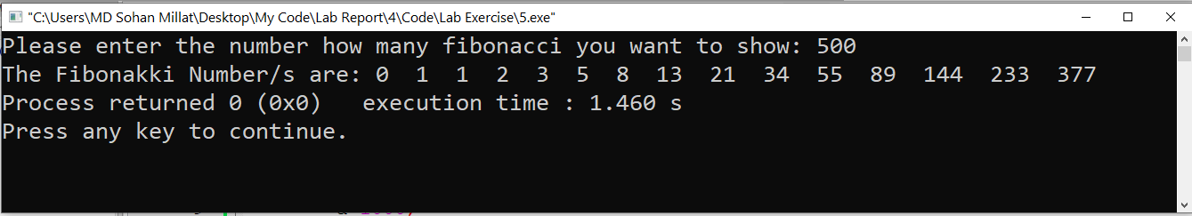
Test result:
Discussion: To solve this problem I don’t face any problem…

